Slide 1
Introduction to Map-Reduce
Owais A. Hussain

Slide 2
History
Divide and conquer methodology
Parallel Processing
Scalability Problem
3V’s of Big Data
Velocity
Volume
Variety

Slide 3
Hadoop and Map-Reduce
Apache Hadoop
Parallel Processing
Parallel Storage
Fail-safe Operation
Map-Reduce – programming model for large-scale parallel data processing
Old Idea on Scale
Key-value Pairs
Map Function: tokenizer
Reduce Function: joiner

Slide 4
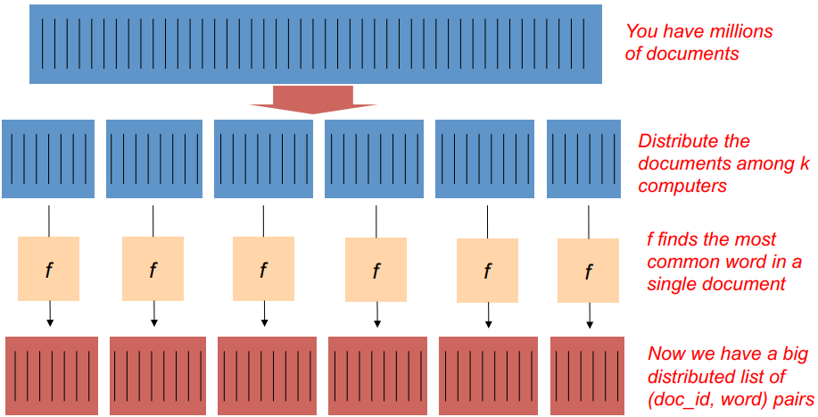
Find the most common Greek word…

Slide 5
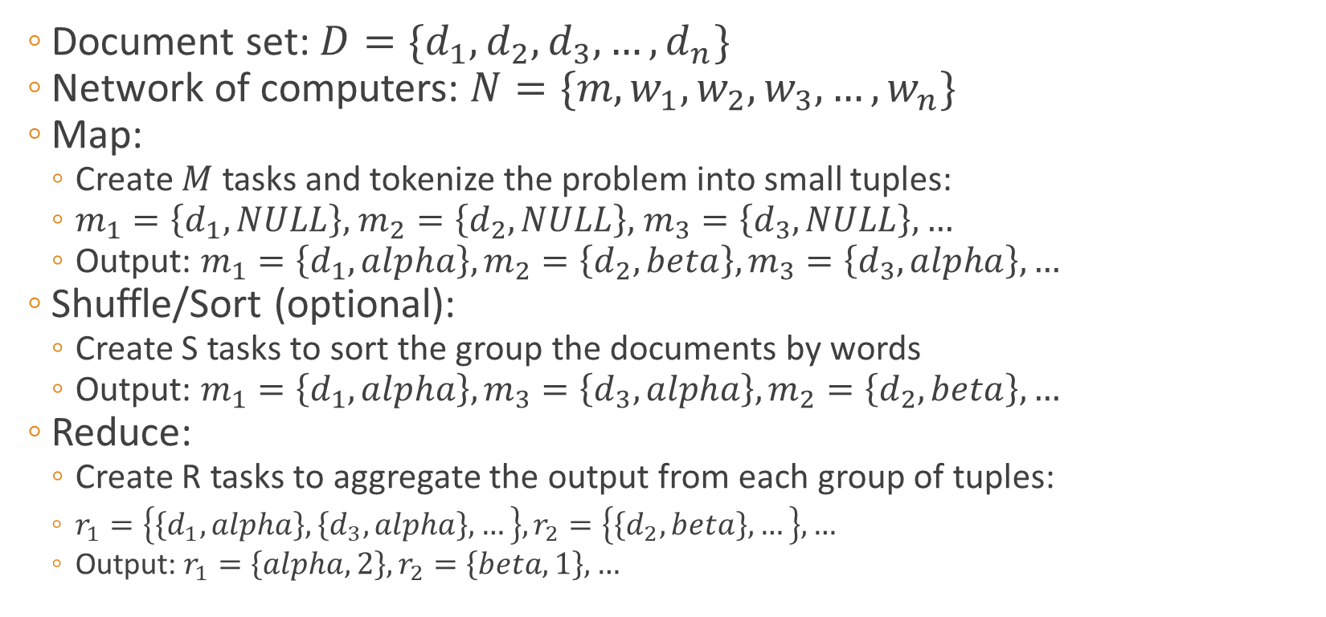
Execution
Document set: ${D=\{d}_{1}, d_{2},d_{3},…,d_{n}\}$
Network of computers: $N=\{m,w_{1},w_{2},w_{3},…,w_{n}\}$
Map:
Create $M$ tasks and tokenize the problem into small tuples:
$m_{1}=\left\{d_{1},NULL\right\},$ $m_{2}=\left\{d_{2},NULL\right\},$ $m_{3}=\left\{d_{3},NULL\right\},…$
Output: $m_{1}=\left\{d_{1},alpha\right\},m_{2}=\left\{d_{2},beta\right\},m_{3}=\left\{d_{3},alpha\right\},…$
Shuffle/Sort (optional):
Create S tasks to sort the group the documents by words
Output: $m_{1}=\left\{d_{1},alpha\right\},m_{3}=\left\{d_{3},alpha\right\},m_{2}=\left\{d_{2},beta\right\},…$
Reduce:
Create R tasks to aggregate the output from each group of tuples:
$r_{1}=\left\{\left\{d_{1},alpha\right\},\left\{d_{3},alpha\right\},…\right\},r_{2}=\left\{\left\{d_{2},beta\right\},…\right\},…$
Output: $r_{1}=\left\{alpha,2\right\},r_{2}=\left\{beta,1\right\},…$

Slide 6
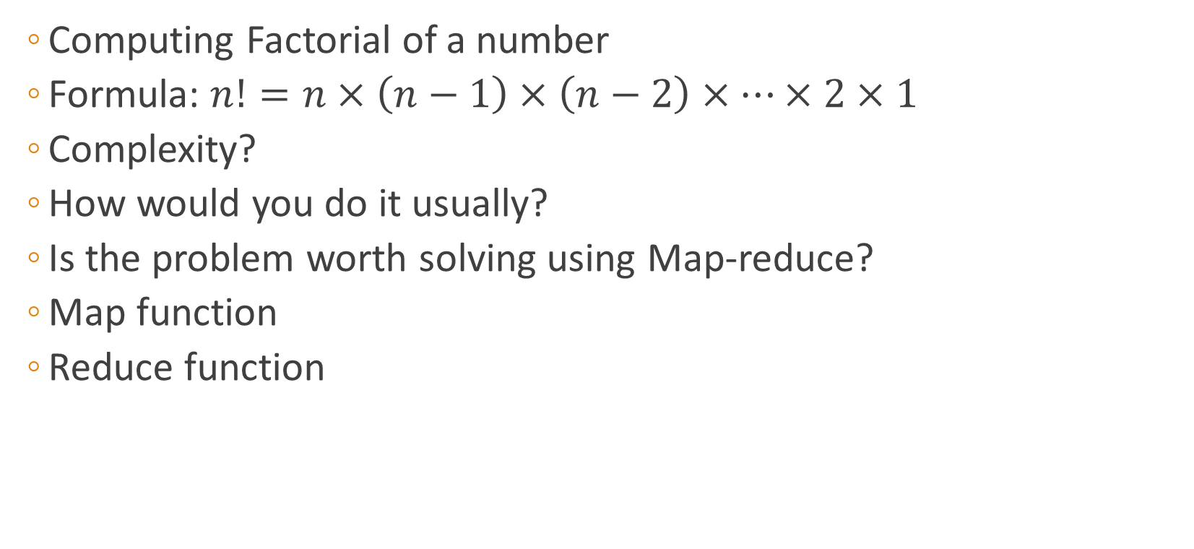
Interactive Example
Computing Factorial of a number
Formula: $n!=n×\left(n−1\right)×\left(n−2\right)×…×2×1$
Complexity?
How would you do it usually?
Is the problem worth solving using Map-reduce?
Map function
Reduce function

Slide 7
DIY
Setting up Hadoop on Virtual machine:
Single-node: https://goo.gl/ndo3HA
Multi-node: https://goo.gl/Vf3kJi
Writing your own Map-reduce programs: https://goo.gl/uNQVfM

Slide 8
?

Slide 9
Thank you…

